Slide 1



HEALTHCARE EMPLOYEE ATTRITION PREDICTION MODEL
by: Hugi Munggaran

Slide 2



TODAY'S AGENDA
Introduction
Project Framework
Data Pre-Processing
Data Modelling
Model Comparison
Conclusion

Slide 3

INTRODUCTION
Attrition of healthcare workers in the US Healthcare system is at an all-time high. It has become a major area of focus, especially for hospitals looking to retain their staff.
My goal is to predict employee attrition among healthcare workers. Accurate predictions can inform more effective retention strategies and contribute to a more stable healthcare work environment..
The dataset is derived from the IBM Watson dataset on attrition, available on Kaggle.com. It is comprehensive, containing 48 columns that provide various insights into employee demographics, job characteristics, and other factors relevant to attrition.

Slide 4






PROJECT FRAMEWORK
EMPLOYEE ATTRITION DATABASE
DATA CLEANING AND PREPROCESSING
DATA MODELING
MODEL COMPARISON

Slide 5


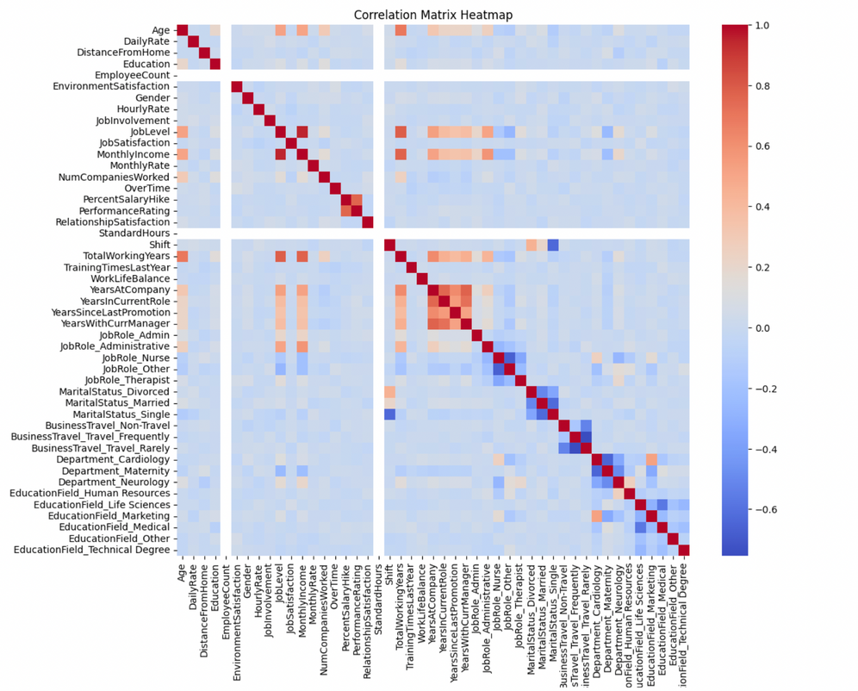


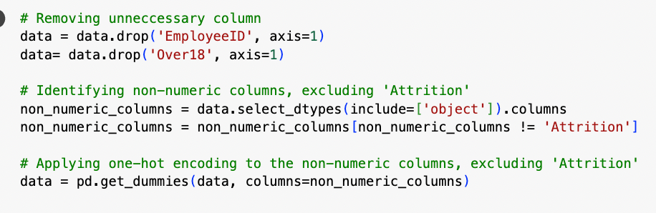

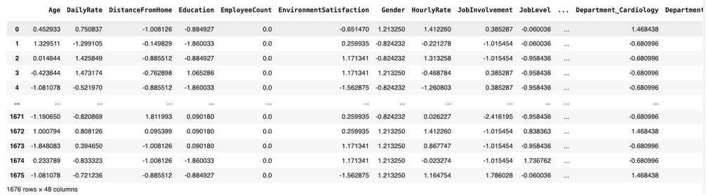
DATA CLEANING AND PREPROCESSING
PLOT CORRELATION MATRIX AND SEE IF ANY MULTICOLINEARITY
CHECK DUPLICATE, MISSING VALUE and CONVERT CATEGORICAL INTO BINARY
FEATURE REMOVAL
DATA SCALING

Slide 6



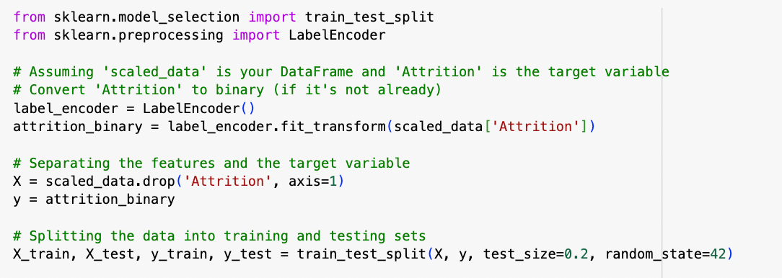
DATA MODELING
ATTRITION AS A TARGET VARIABLE
APPLY PREDICTION MODELS
LOGISTIC REGRESSION
LINEAR DISCRIMINANT ANALYSIS
QUADRATIC DISCRIMINANT ANALYSIS
RANDOM FOREST
DECISION TREE
SVM
KNN
SPLITTING THE DATA INTO TRAINING AND TESTING

Slide 7
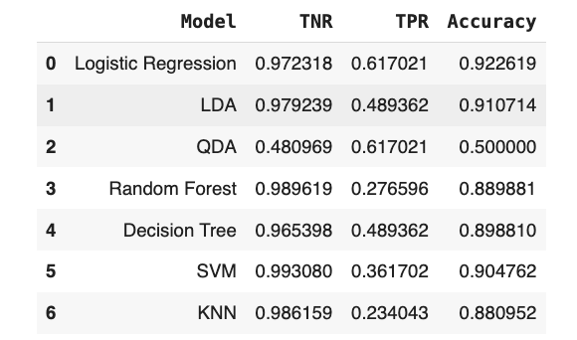

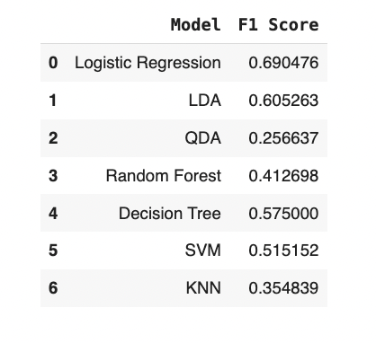
MODEL COMPARISON

Slide 8

CONCLUSION
Based on this project, Logistic Regression is the most effective model for predicting employee attrition, with the highest accuracy and F1 score among the evaluated models. Its accuracy rate of approximately 92.3% suggests it is reliable for correctly identifying cases of attrition.

Slide 9


THANK YOU!!

